Slide 1
September 20, 2024
Lunch & Learn
Postsecondary Fall Requirements
A Deeper Dive

Slide 2
AGENDA
1: Overview of fall requirements
2: Registration Form and Elections Information Requirement
3: Annual Report of Registration Form Distribution
4: Overview of Voter Engagement Plan Requirement
5: Tips and Suggestions from the ALL IN 9 action plan sections
6: Questions

Slide 3
Fall Requirements
1: Registration Info/Forms/Links (Email?)
2: Annual Report of Registration Form Distribution
4: Voter Engagement Plan

Slide 4
Fall Requirements
1: Registration Info/Forms/Links (Email?)
-Requirement: “All postsecondary institutions that enroll students accepting state or federal financial aid must provide voter registration forms to each student during the fall and spring of each year. In state election years, it must be provided 15 days in advance of the deadline for registering to vote for the state general election. If the voter registration forms are provided electronically, the electronic message must be devoted exclusively to voter registration.”

Slide 5
Fall Requirements
1: Registration Info/Forms/Links (Email?)
-Oh, come on!
-Registration (online, paper, election day (incl. cons for this)
-Ways to vote
-By mail (need a witness; returned in-hand by 8 p.m. 11/5)
-Early in-person (Every county. On campus? No witness!)
-On Election Day (Reg. by 10/15 online or on paper!)
-Sample ballot
-Polling place finder
-Why voting is important
-Resources (what a polling place looks like, candidate info sources, etc.)

Slide 6
Fall Requirements
2: Annual Report of Registration Form Distribution
-Google Form link we will send (November 1?)
-Due by November 31
-School and contact info, and 3 columns:
-Registration info distributed Spring: when and how
-Registration info distributed Fall: when and how]
-What went well? SHARING! (Civic Show and Tell)

Slide 7
Fall Requirements
3: Voter Engagement Plan
-Takes the most time and planning
-Biggest payoff

Slide 8
What is a Voter Engagement Plan?
A Voter Engagement plan is a dynamic document developed by a campus voting coalition (staff, faculty, administration, and students) for a campus to document a set of goals and planned efforts to institutionalize and increase nonpartisan democratic engagement and student voting.

Slide 9
How to develop a voter engagement Plan
Form a campus voting coalition if one doesn’t already exist.
Set goals and create calendar of items and actions (and resources and people) to meet those goals (communications, activities, etc.);
-You can use the Strengthening American Democracy Guide
-It has 9 sections to the action plan with guiding questions
Work with partners/resources/nonprofits that support action planning
E.g., MN Secretary of State, your system/association (LEADMN, Students United, UMN System, MPCC), ALL IN, Andrew Goodman Foundation, Ask Every Student, Campus Vote Project, Students Learn Students Vote, the Voter Friendly Campus Initiative, etc., etc.
Plan to submit a report and final plan to OSS by November 31, 2024.

Slide 10
RESOURCE: Strengthening American Democracy Action Planning Guide
Notes:
Jen/Ryan
2nd edition focuses more on equity and inclusion and closing gaps in participation on campus

Slide 11
Strengthening American Democracy Guide
01
Provides a summary/overview of the entire action plan.
EXECUTIVE SUMMARY
02
Describes the team responsible for campus efforts to increase civic learning, democratic engagement, and voter participation.
LEADERSHIP
03
Describes how campus demonstrates its commitment to increasing civic learning, political engagement, and voter participation.
COMMITMENT
04
A self-assessment of current work and data - describes climate, programming, and student engagement.
LANDSCAPE
05
Short-term and long-term goals for increasing civic learning, political engagement, and voter participation inline with campus mission.
GOALS
Notes:
Cat - General overview.

Slide 12
Strengthening American Democracy Guide
06
Describes campus NSLVE data - general and demographic - later tied to goals/strategy.
NSLVE
07
Strategic plan for achieving goals.
STRATEGY
08
Plans to report on action planning process, share action plan and the results of implementing the action plan - including sharing NSLVE data.
REPORTING
09
Describes how the plan will be evaluated and continuously improved.
EVALUATION
Notes:
Cat
Definitions, guiding questions, past webinars

Slide 13
Executive Summary
Overview of the action plan includes responses to all 6 of the suggested guiding questions.
President can read executive summary and have a good understanding of the plan.
Who Developed the Action Plan?
Individuals, name of campus voting coalition, key coalition members, departments
Purpose of The Plan
Create a strategic document to plan and implement efforts to increase nonpartisan democratic engagement
Where the Plan will be Implemented?
Campus name(s) - if multiple campuses list them and the city and state.
Goals of the Plan
High level goals - e.g. voter turnout, voter registration, voter education goals
Duration of the Plan
What is the beginning and end date of this plan?
How The Plan will be Implemented?
People, resources, high level strategies
13

Slide 14
Leadership
Names and titles of members of campus voting coalition
Categories of members involved in your campus voting coalition
Students - representative of your campus community
Faculty - beyond just social sciences, use NSLVE data voting rates by area of study to recruit
Student affairs staff and representatives from the office of the president/chancellor
Community and national partners - League of Women Voters, Campus Vote Project, etc.
Local election administration officials - clerks, auditors
Roles and responsibilities
Include details about who is responsible for specific parts of your action plan
Director of Residence Life will organize trainings for Resident Assistants
Leadership succession plan
Is this work part of someone’s job description to lead? How are new members and leaders recruited and trained?
14

Slide 15
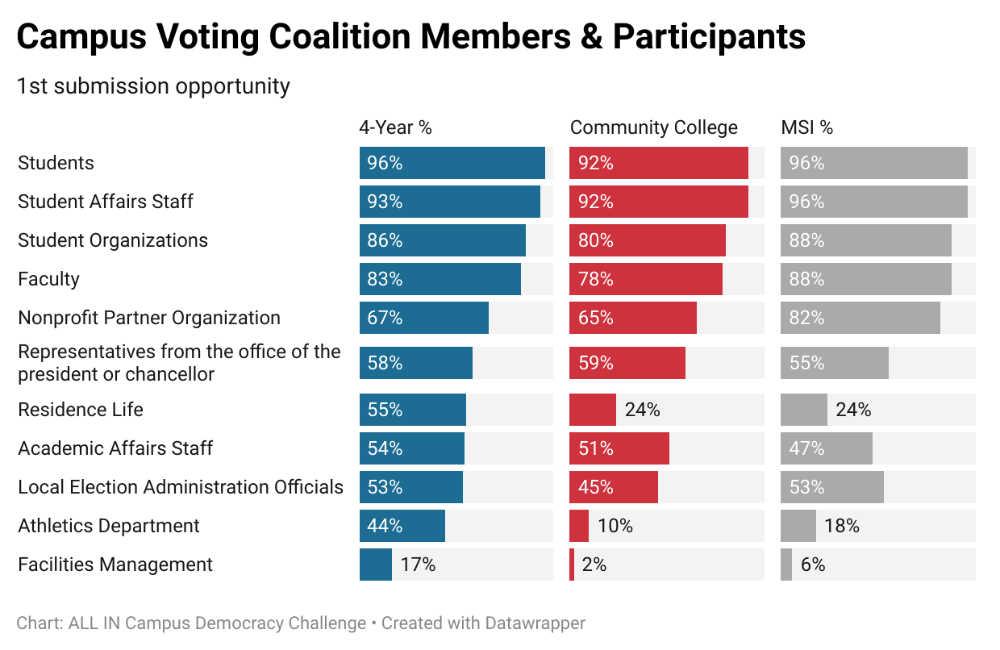
Campus Voting Coalition
15

Slide 16
Leadership Succession
2024 Action Plan Reviewers identified 48% of action plans that included a leadership succession plan, up from 31% in 2022.
16

Slide 17
Commitment
According to the plan, institutional commitment is visible and widely communicated - internally and externally. It is woven into the culture of the institution and is clearly reflected in the institution’s mission, learning outcomes, curriculum, and co-curriculum.
Signatory to the ALL IN Presidents’ Commitment to Full Student Voter Participation
Democratic engagement is visible on campus through communication to students, events, panels, debates, etc.
Required courses have civic and democratic engagement components
E.g., 1 credit required civic engagement course to graduate
17

Slide 18
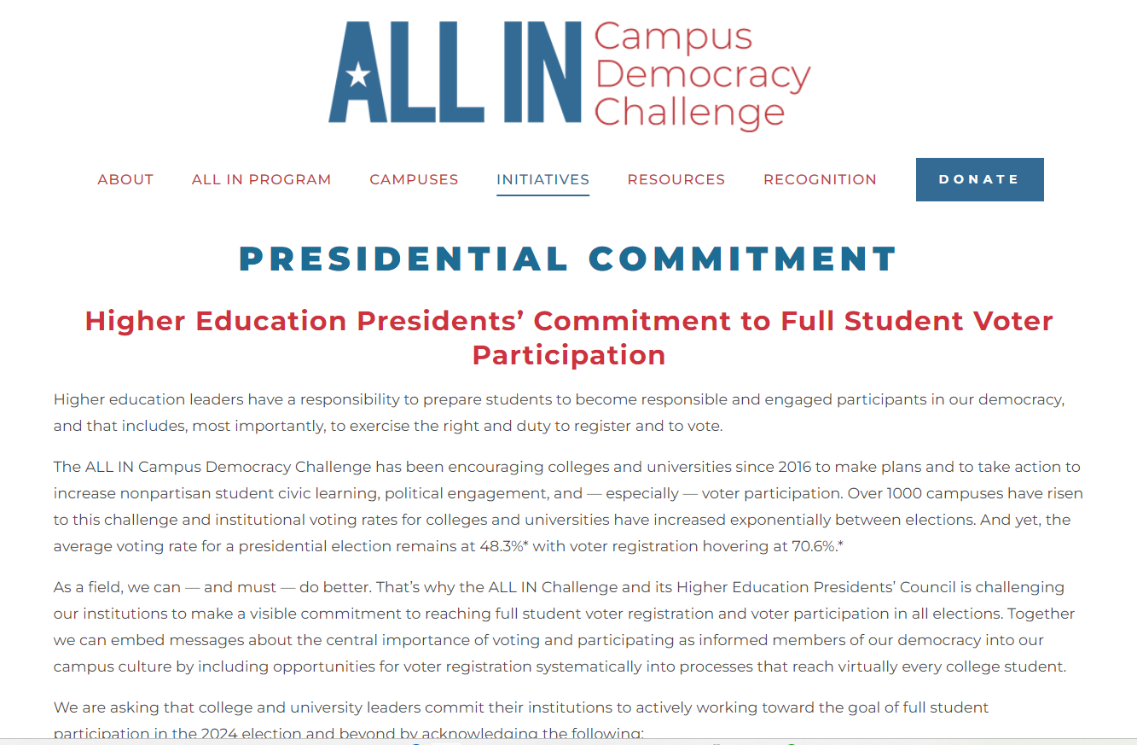
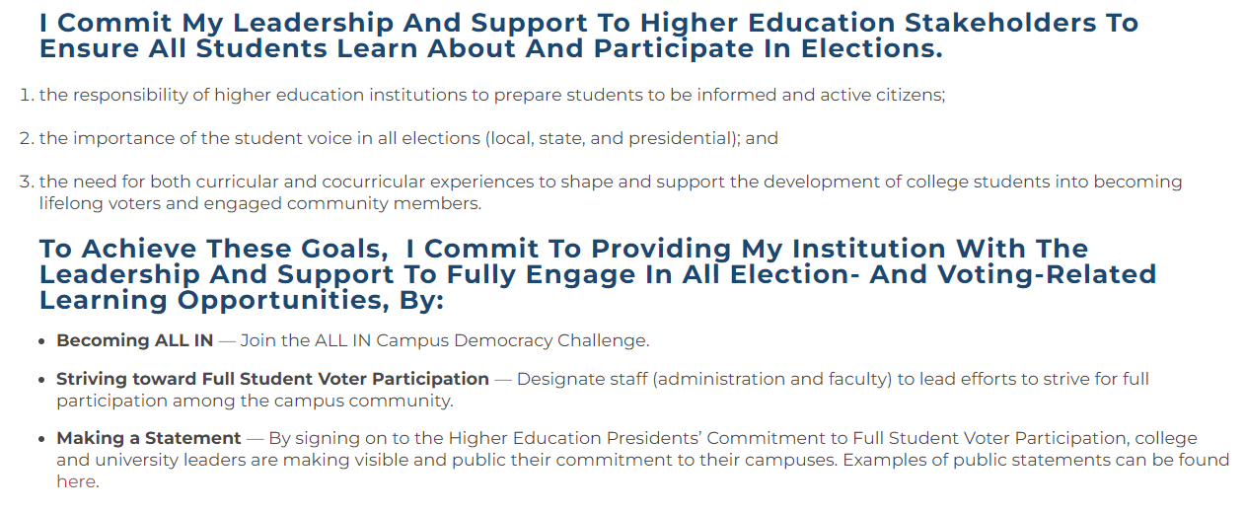
18

Slide 19
Landscape
The plan communicates a comprehensive understanding of its students, campus efforts, and climate; AND is using this information to inform its strategy
Demographic overview of student body
In-state vs. out-of-state, residential vs. commuter students, 1st generation, race/ethnicity breakdown, etc.
Overview of campus voting data through NSLVE
Include topline voting data and data by age, class year, race/ethnicity, area of study, vote method, etc.
Use screenshots from your 2022 NSLVE report
Climate for nonpartisan political engagement on campus
Engagement level of students, candidate visits, polling locations
Election laws
Existing or new election laws that impact your strategy - e.g., voter IDs, election day voter registration
19

Slide 20
Goals
Short-term and long-term democratic engagement goals are described. Goals are also S.M.A.R.T.I.E., Specific, Measurable, Ambitious, Realistic, Timebound, Inclusive, and Equitable.
Voter turnout and voter registration
Overall goal for the campus and goals to close any participation gaps in your NSLVE data
Short-term Next election (2024)
Long-term Future elections 2-4+ years into the future
Programmatic goals
Grow your coalition, add voter registration to new student orientation, create a student ambassador program, develop relationships with local election officials.
Metrics and evaluation
What metrics, beyond NSLVE data, will you track to be able to evaluate progress towards your goals?
20

Slide 21
NSLVE
Summary AND detailed (e.g., demographic) NSLVE data are described and specific goals based on these data are set.
NSLVE = National Study of Learning, Voting, and Engagement at Tufts University
NSLVE data can show up in many sections of your action plan, especially Landscape
Goals based on NSLVE data, especially about closing any participation gaps
What if our institution hasn’t authorized NSLVE?
Mention this in your action plan and include a goal to authorize NSLVE by a specific date.
21

Slide 22
NSLVE
22

Slide 23
NSLVE
23

Slide 24
Strategy
Strategy includes short-term tactics and long-term strategies. Tactics include a description of multiple voter registration, voter education, and voter turnout activities. Long-term strategies seek to make civic learning and democratic engagement an established part of the institution’s curriculum and co-curriculum and go beyond the election.
Voter registration, voter education, and voter turnout activities
Short-term This election cycle - participate in Civic Holidays
Long-term Add civic and democratic engagement learning outcomes to required courses, add voter registration to new student orientation
Inside and outside of the classroom
Learning outcomes, classroom presentations, learning management systems
Civic holidays, debate watch parties, march to the polls
24

Slide 25
Reporting
Action plan and NSLVE reports are shared on campus AND are publicly available.
Make it easy for campus stakeholders and community members to find this information
How are your action plan and NSLVE reports shared with the campus community?
Emailed to key stakeholders, presented at meetings, posted on a campus website, etc.
With whom are these shared?
Office of the president/chancellor, community partners, local election administration officials, student government, etc.
Post your action plan and NSLVE reports on a campus webpage
Include a link to the url in the reporting section of your action plan
How do you share your successes? Include recognition and awards you’ve earned for this work.
This section is not about media report and press hits, though those can be included in your action plan.
25

Slide 26
Evaluation
What metrics are you collecting beyond NSLVE data?
Attendance at events, # of pledges to vote and voter registrations, campus surveys, NSSE, etc.
How are you collecting this data?
GivePulse, student ID swipes, collecting Pledge to Vote cards, your own spreadsheets and process to collect data in a centralized place
Who is collecting this data and who is analyzing the data?
Opportunity to engage members of your coalition - math and stats departments!
Occurs before, during, and after implementation
E.g., first 3 voter reg drives weren’t successful, what can be changed before registration deadline?
Organize and present data in future action plans
Future members of the coalition will be grateful to know about past strategies and how effective they were compared to previous election cycles to develop strategies for the future
26

Slide 27
Action Plan Feedback (All in and OSS)
83% of campuses that previously submitted an action plan reported using their action plan feedback for their 2024 action plan.
ALL IN provides a confidential score based on the 9 sections of the Strengthening American Democracy Guide as well as comments from action plan reviewers for each section.
One page from a campus action plan feedback report.
27

Slide 28
QUESTIONS
28

